Slide 1
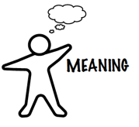
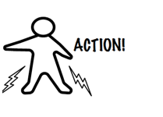
Focused Conversation
Facilitating Shared Awareness
California SNAP-Ed ToP Facilitation Virtual Mentoring Project

Slide 2
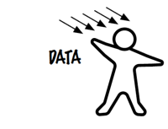
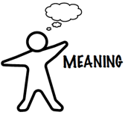
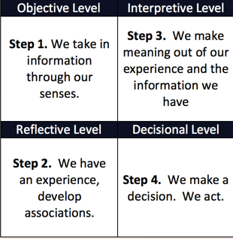
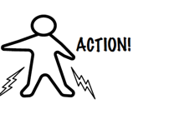
Focused Conversation
Focused Conversation follows a neurological journey represented by the four steps below. ToP refers to these as ORID.
Images on the cover page, this and next two pages from Dendros Group, from their Good Work Tool set.
See http://dendros.com/good-work-tools/
California SNAP-Ed ToP Facilitation Virtual Mentoring Project

Slide 3
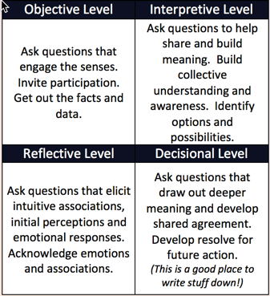
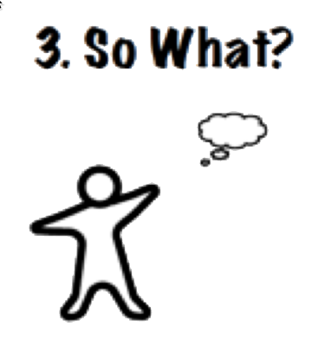
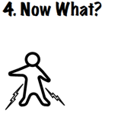
Focused Conversation
Focused conversation not only mirrors the way the brain functions, it helps the group journey together, providing an opportunity for the group to take all the data and establish deeper understanding and shared awareness.
Do:
Affirm participation.
Remain neutral.
Get everyone's answer on the initial (objective) question - which is always VERY easy to answer.
Don't:
Ask yes/no or why questions.
Paraphrase what has been said. If a summary is needed, let the group do it
California SNAP-Ed ToP Facilitation Virtual Mentoring Project

Slide 4
Focused Conversation - Sample Questions
1. What? (Objective) | 3. So What? (Interpretive)
What happened? What did you see or hear? Who was there? What are some things we did? What do you notice about this? What facts do we know? (Remember to go around the group on the first question to cultivate participation: e.g., What's one thing you saw or heard?) | What is the significance of this? What options are open to us? What insights are beginning to emerge? What kind of changes would we need to make? How well have we lived up to our expectations? What new vantage point does this give us? What underlies these issues? What are we being compelled to consider?
2. Gut? (Reflective) | 4. Now What? (Decisional)
Where were you surprised? Where were you concerned? What was annoying? What was inspiring or hopeful? What was easy or difficult? Where were you engaged or not engaged? When where you bored? When were you excited? | What are we going to do? What are our next steps? Who will do it? By when? What will we do differently next time? What are we really committed to do? How will we apply what we just learned?
California SNAP-Ed ToP Facilitation Virtual Mentoring Project

Slide 5
Focused Conversation as a Framework
Focused Conversation can be used in groups of any size. Larger groups can be divided into small teams.....
Group conversation on a topic- help the group process the information together, as each person engages at questions designed to enable everyone to pay attention to information at each stage.
Individual application - methodically think through an issue to be more mindful about influencing factors.
Structure for a larger event -
Sample framework for event as a focused conversation - 1 day conference:
Morning |  | Afternoon
Before break Objective | After Break Reflective | Before Break Interpretive | After Break Decisional
Share peoples' real life experience about the topic. Share what is known about the topic. Review the facts and data. Have relevant presentations or conversations. Review reports. | Facilitate reactions to data, presentations or reports. Determine what people like and dislike or other feelings prompted by the data. Ask about relevant experiences from the past (associations). | Discuss meaning, significance and implications. Surface best practices. Brainstorm possible responses. Evaluate and prioritize options. Determine missing pieces that need to be addressed. Discuss lessons learned. | Determine what actions the group will take. (Choosing no action is a decision.) Facilitate individual resolve in relation to the topic. Create group resolve. Adopt a course of action and schedule follow up planning session, if necessary.
California SNAP-Ed ToP Facilitation Virtual Mentoring Project

